Slide 1
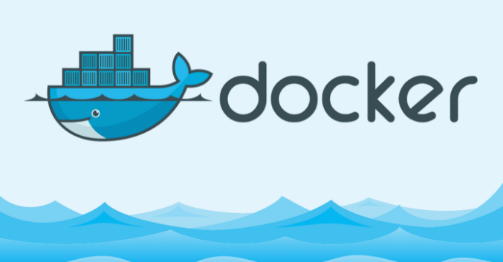

Slide 2
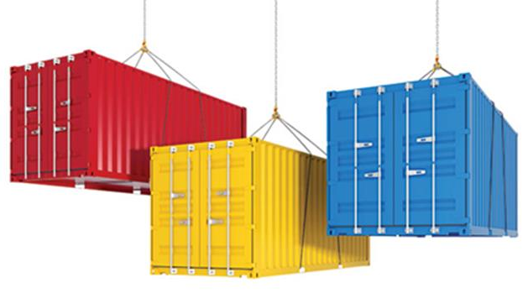
What is containerisation?
Containers are lightweight software components that bundle an application, its dependencies, and its configuration in a single image, running in isolated user environments on a traditional operating system on a traditional server or in a virtualized environment.
The key word here is “isolated.” Isolation means speed—containers are smaller entities than virtual machines so they can be deployed much faster. Isolation means responsive—start-up times are short. Isolation means versatility—containers are portable between different platforms and different cloud vendors.
Containerization of applications brings benefits, including the following:
Portability between different platforms and clouds
Easier management since install, upgrade, and rollback processes are built into the Kubernetes platform.
Faster app start-up and easier scaling.
Improved security by isolating applications from the host system and from each other.

Slide 3
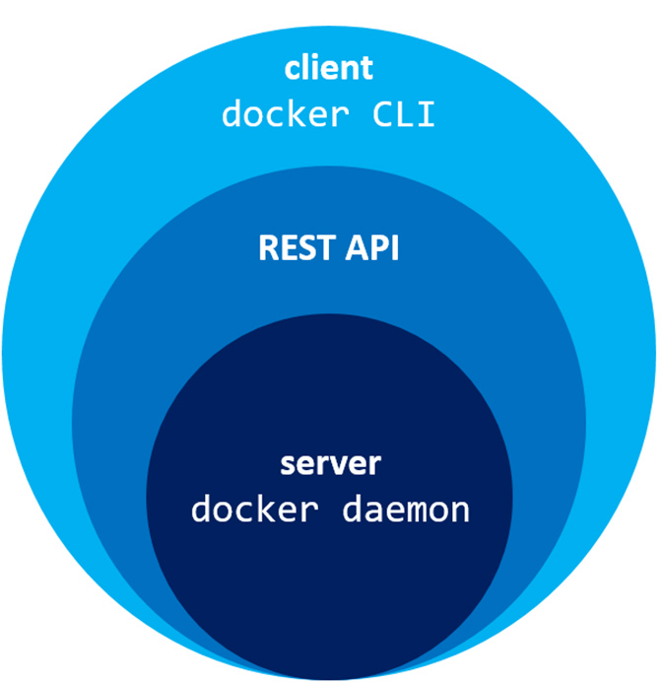
What is Docker?
Docker is a open-soure tool and is the most well-known and highly used container engine technology.
The Docker Engine allows you to develop, assemble, ship, and run applications using the following components:
Docker Daemon: A persistent background process that manages Docker images, containers, networks, and storage volumes. The Docker daemon constantly listens for Docker API requests and processes them.
Docker Engine REST API: An API used by applications to interact with the Docker daemon; it can be accessed by an HTTP client.
Docker CLI: A command line interface client for interacting with the Docker daemon. It greatly simplifies how you manage container instances and is one of the key reasons why developers love using Docker.

Slide 4
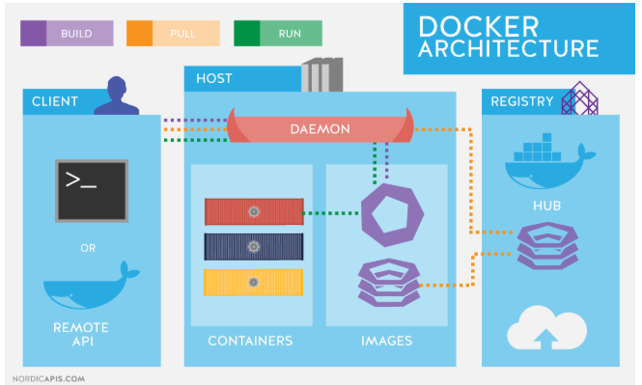
Docker Architecture
The Docker architecture uses a client-server model and comprises of the Docker Client, Docker Host, Network and Storage components, and the Docker Registry/Hub.
Docker Client enables users to interact with Docker. The Docker client can reside on the same host as the daemon or connect to a daemon on a remote host. A docker client can communicate with more than one daemon. The Docker client provides a command line interface (CLI) that allows you to issue build, run, and stop application commands to a Docker daemon.
Docker Host provides a complete environment to execute and run applications. It comprises of the Docker daemon, Images, Containers, Networks, and Storage. The daemon is responsible for all container-related actions and receives commands via the CLI or the REST API.
Docker registries are services that provide locations from where you can store and download images. A Docker registry contains Docker repositories that host one or more Docker Images. Public Registries include Docker Hub and Docker Cloud and private Registries can also be used

Slide 5
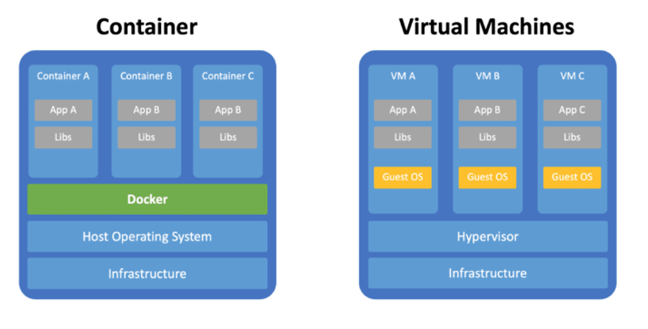
Containers vs. VMs
When talking about containerisation it is very often compared to virtual machines.
The Docker container platform is always running on top of the host operating system. Containers are containing the binaries, libraries, and the application itself. Containers do not contain a guest operating system which ensures that containers are lightweight.
In contrast virtual machines are running on a hypervisor (responsible for running virtual machines) and include it’s own guest operating system. This increased the size of the virtual machines significantly, makes setting up virtual machines more complex and requires more resources to run each virtual machine.

Slide 6
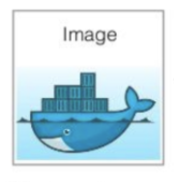
Docker Objects - Images
Images are a read-only binary template used to build containers. Images also contain metadata that describe the container's capabilities and needs. Images are used to store and ship applications. An image can be used on its own to build a container or customized to add additional elements to extend the current configuration. Container images can be shared across teams within an enterprise using a private container registry, or shared with the world using a public registry like Docker Hub.
A Docker image is containing everything needed to run an application as a container. This includes:
code
runtime
libraries
configuration files

Slide 7
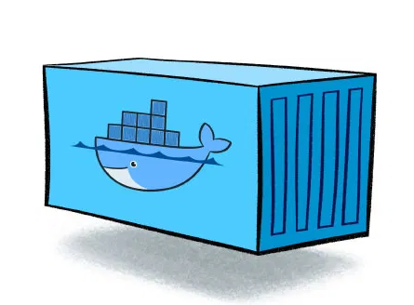
Docker Objects - Containers
Containers are encapsulated environments in which you run applications.
The container is defined by the image and any additional configuration options provided on starting the container, including and not limited to the network connections and storage options.
Containers only have access to resources that are defined in the image, unless additional access is defined when building the image into a container.

Slide 8
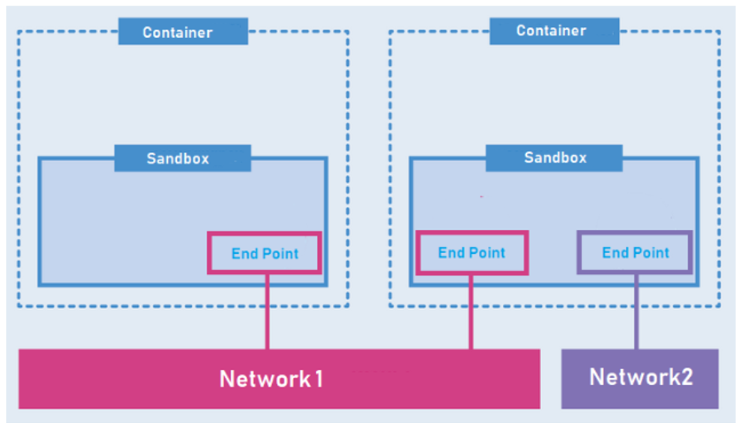
Docker Objects - Networking
Docker implements networking in an application-driven manner and provides various options while maintaining enough abstraction for application developers.
There are basically two types of networks available - the default Docker network and user-defined networks. By default, you get three different networks on the installation of Docker - none, bridge, and host.

Slide 9
Docker Objects - Storage
You can store data within the writable layer of a container. Being non-persistent, it perishes whenever the container is not running. Moreover, it is not easy to transfer this data. In terms of persistent storage, Docker offers four options:
Data Volumes
Data Volume Container
Directory Mounts
Storage Plugins

Slide 10
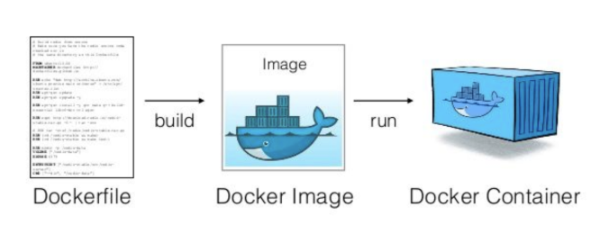
Dockerfile
A Dockerfile is a file that defines a set of instructions that creates an image. Each instruction in the Dockerfile creates a layer in the image. For the most part, when you rebuild the image, only the layers that have changed are rebuilt.
The Dockerfile can be distributed to others and allows them to recreate a new image in the same manner you created it. While this allows you to distribute the instructions on how to create the image, the main way to distribute your image is to publish it to a registry.

Slide 11
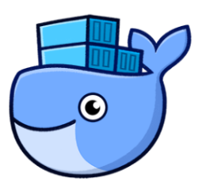
Docker Desktop
https://www.docker.com/products/docker-desktop
Docker Desktop is an easy-to-install application for your Mac or Windows environment that enables you to build and share containerized applications and microservices.
Docker Desktop includes Docker Engine, Docker CLI client, Docker Compose, Notary, Kubernetes, and Credential Helper.
Some of the key features of Docker Desktop include:
Ability to containerize and share any application on any cloud platform, in multiple languages and frameworks
Easy installation and setup of a complete Docker development environment
Automatic updates to keep you up to date and secure
On Windows, the ability to toggle between Linux and Windows Server environments to build applications
Fast and reliable performance with native Windows Hyper-V virtualization
Ability to work natively on Linux through WSL 2 on Windows machines
Volume mounting for code and data, including file change notifications and easy access to running containers on the localhost network
In-container development and debugging with supported IDEs

Slide 12
Docker Hub
Docker Hub is a service provided by Docker for finding and sharing container images. It provides the following major features:
Repositories: Push and pull container images.
Teams & Organizations: Manage access to private repositories of container images.
Official Images: Pull and use high-quality container images provided by Docker.
Publisher Images: Pull and use high- quality container images provided by external vendors. Certified images also include support and guarantee compatibility with Docker Enterprise.
Builds: Automatically build container images from GitHub and Bitbucket and push them to Docker Hub.
Webhooks: Trigger actions after a successful push to a repository to integrate Docker Hub with other services.
https://hub.docker.com/search?q=&type=image

Slide 13
Demo
Demo Docker with C# Mircoservice

Slide 14
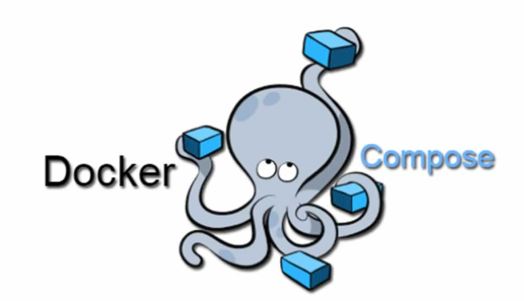
Docker-compose
Compose is a tool for defining and running multi-container Docker applications. With Compose, you use a YAML file to configure your application’s services. Then, with a single command, you create and start all the services from your configuration.
Compose works in all environments: production, staging, development, testing, as well as CI workflows. You can learn more about each case in Common Use Cases.
Using Compose is basically a three-step process:
Define your app’s environment with a Dockerfile so it can be reproduced anywhere.
Define the services that make up your app in docker-compose.yml so they can be run together in an isolated environment.
Run docker-compose up and Compose starts and runs your entire app.

Slide 15
Useful Links
Docker Docs: https://docs.docker.com/
Docker Desktop: https://www.docker.com/products/docker-desktop
Docker Hub: https://hub.docker.com/search?q=&type=image

